Slide 1
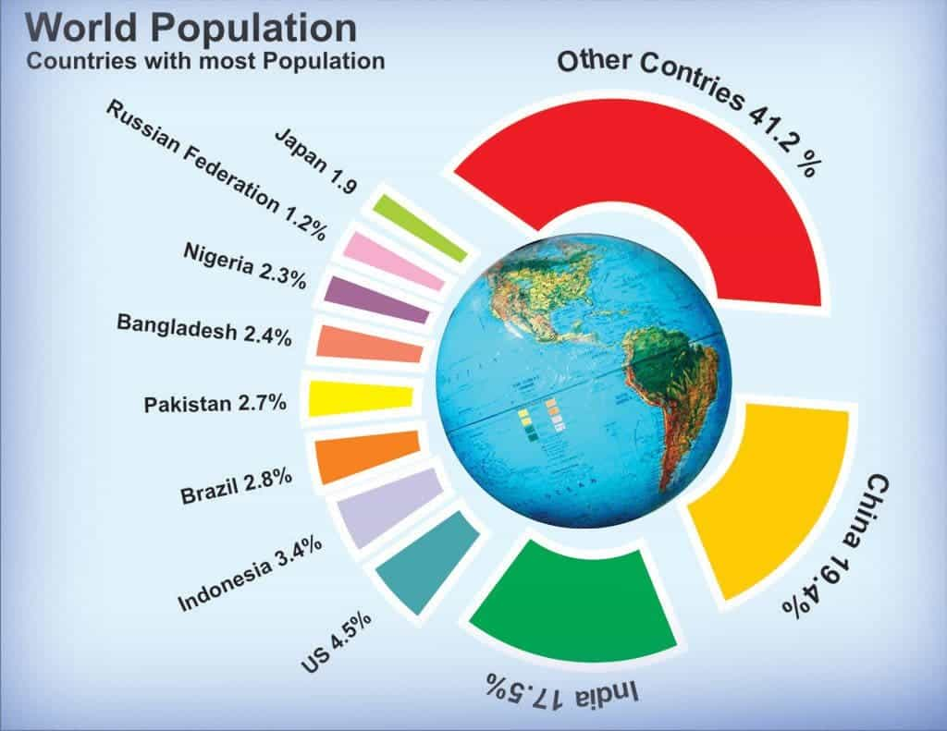
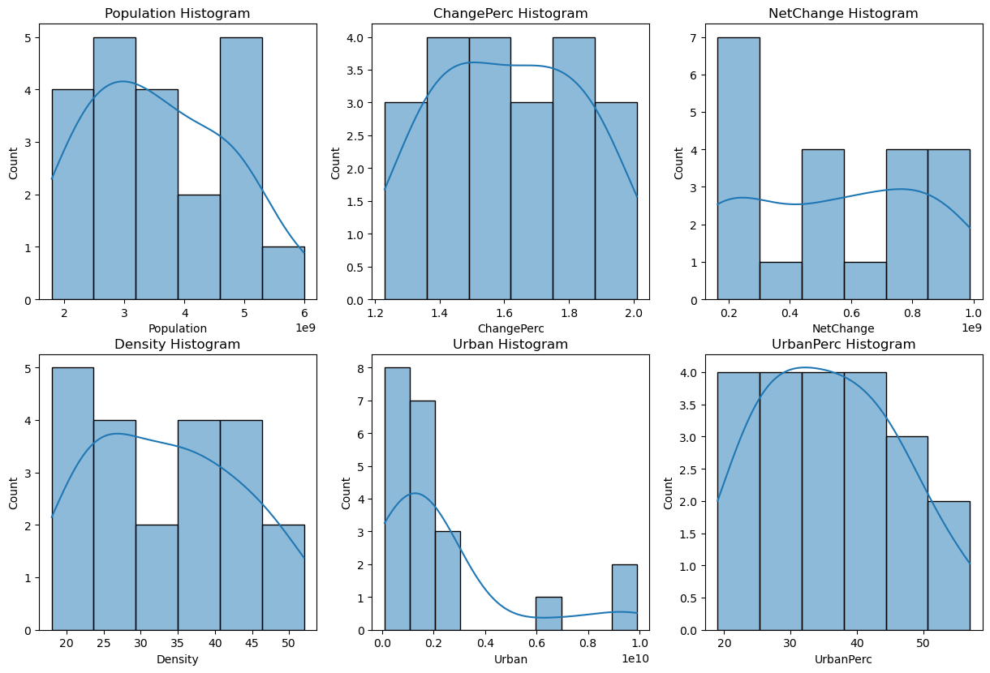
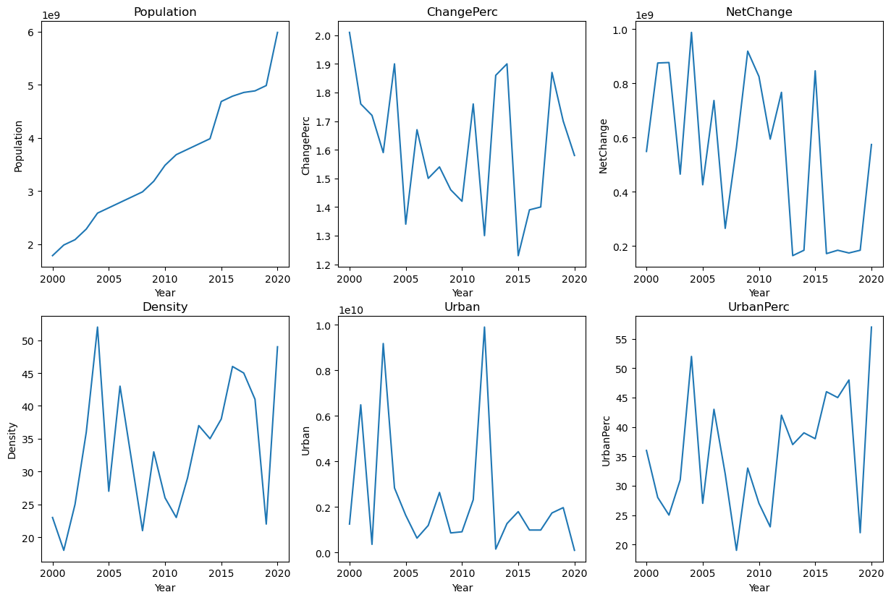
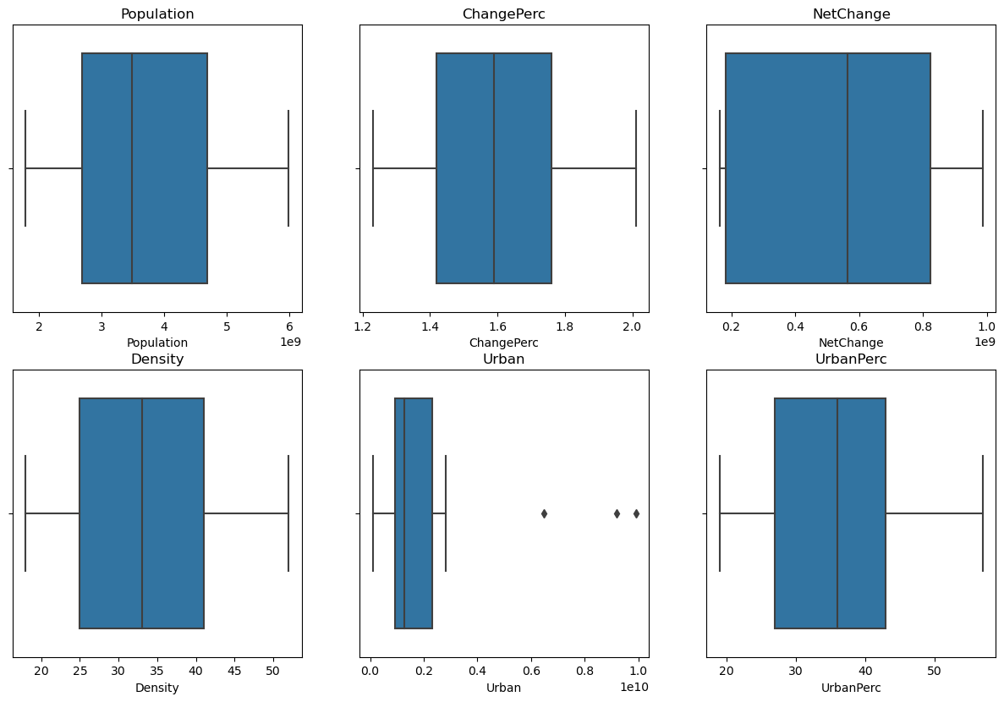
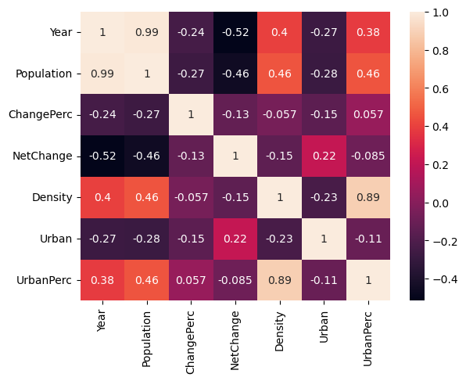
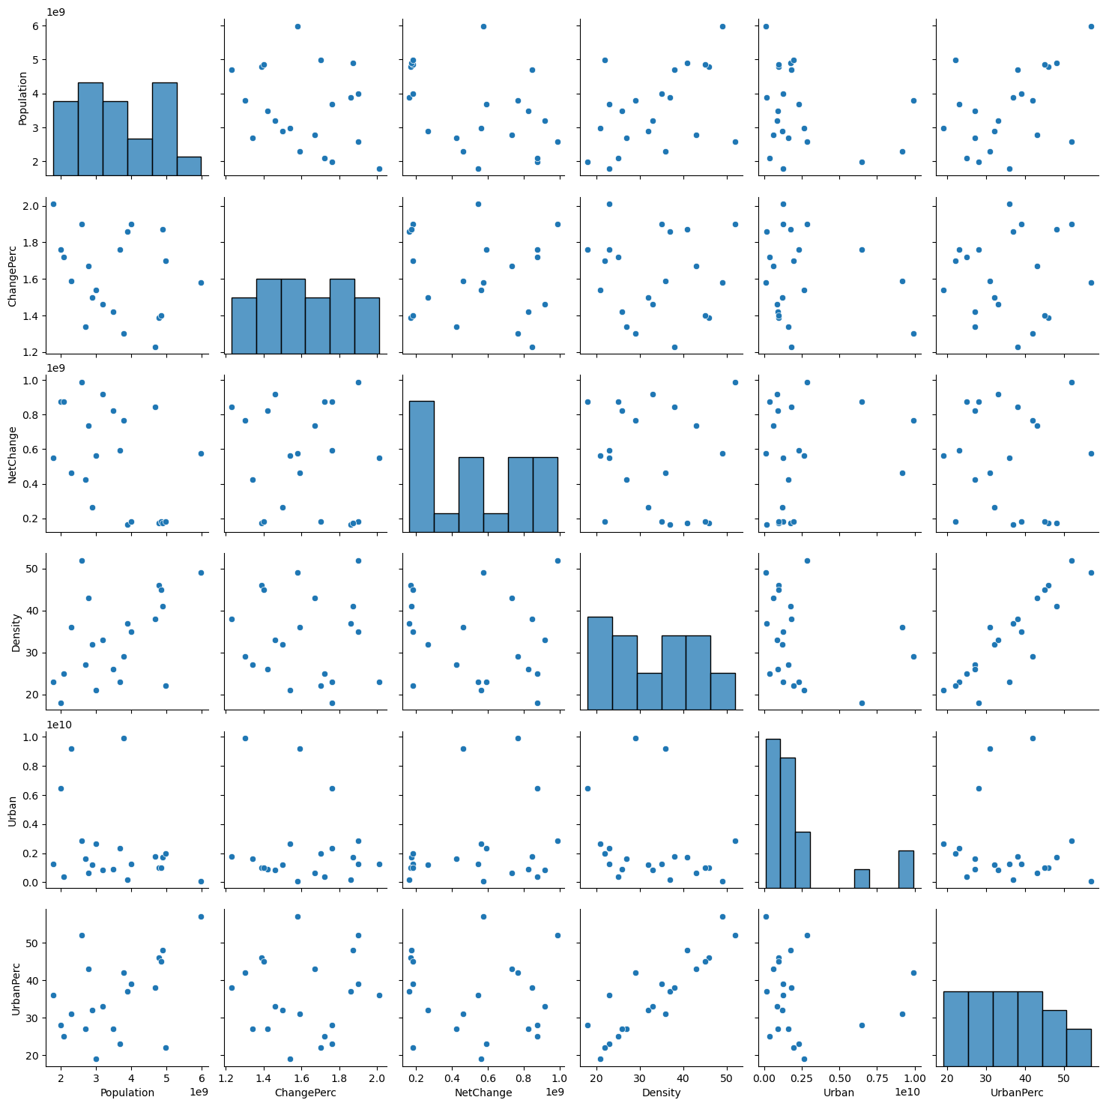
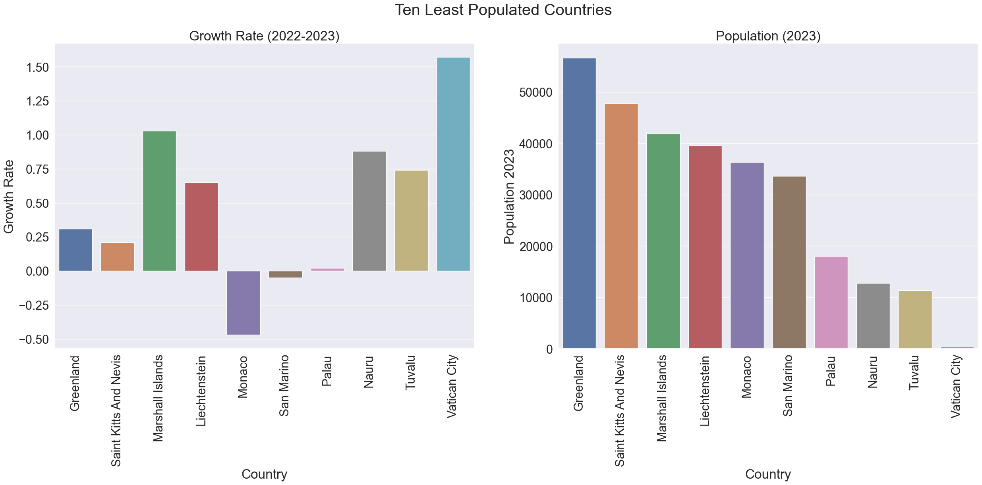
World-population2023
Introduction
According to the United Nations, the world population was estimated to be 7.9 billion in 2021, and it's projected to reach 9.7 billion by next 5 years.
Analysis on below questions
Which countries have the highest growth rate.
What are the densely populated countries in the world.
Keeping in view all the variables in mind which countries should take serious steps to control their population.
Summary of Analysis
Model Accuracy – Score 93.56430720672756
China and India are the most heavily populous countries in the World
About 36 % of the World population resides just in India and China
India has surpassed China as the world's most populous nation
Surprisingly population of China declined by -0.02 percentage as of Jan 2023 compared to the previous year
Vatican City, smallest country in the world in terms of both population and total area, accommodates barely 518 residents
China and India, are far from the most densely populated countries. They are simply too large to have the highest population density
Monaco is the world's most densely populated place
Problem - The increased world population is among the fierce problems the world is facing right now and it will get uncontrolled in the coming future if proper steps for its betterment were not taken immediately. This world has observed the fastest growth during the 20th century. By the end of this year, it will cross 8 billion.
Methodology This dataset is uploaded with the assumption to use Linear Regression, Machine learning and Predictive analytics skills and answer the following questions.
 |  | Population 2023 | Population 2022 | Area(km²) | Land Area(km²) | Density (/km²) | Growth Rate | World % | Rank
No. | Country
0 | India | 1429834379 | 1417173173 | 3.3M | 3M | 481 | 0.91 | 17.85 | 1
1 | China | 1425820141 | 1425887337 | 9.7M | 9.4M | 151 | -0.02 | 17.81 | 2
2 | United States | 339231549 | 338289857 | 9.4M | 9.1M | 37 | 0.5 | 4.25 | 3
3 | Indonesia | 276576867 | 275501339 | 1.9M | 1.9M | 148 | 0.74 | 3.47 | 4
4 | Pakistan | 238517163 | 235824862 | 881.9K | 770.9K | 312 | 1.98 | 3 | 5
5 | Nigeria | 221592544 | 218541212 | 923.8K | 910.8K | 246 | 2.41 | 2.8 | 6
6 | Brazil | 215904975 | 215313498 | 8.5M | 8.4M | 26 | 0.52 | 2.7 | 7
7 | Bangladesh | 172220907 | 171186372 | 147.6K | 130.2K | 1329 | 1.03 | 2.16 | 8
8 | Russia | 144652401 | 144713314 | 17.1M | 16.4M | 9 | -0.19 | 1.8 | 9
9 | Mexico | 128061868 | 127504125 | 2M | 1.9M | 66 | 0.75 | 1.6 | 10
10 | Ethiopia | 125199807 | 123379924 | 1.1M | 1.1M | 112 | 2.55 | 1.58 | 11
11 | Japan | 123569707 | 123951692 | 377.9K | 364.5K | 338 | -0.53 | 1.54 | 12
12 | Philippines | 116598689 | 115559009 | 342.4K | 298.2K | 394 | 1.54 | 1.47 | 13
13 | Egypt | 111991086 | 110990103 | 1M | 1M | 113 | 1.56 | 1.41 | 14
14 | Dr Congo | 100880253 | 99010212 | 2.3M | 2.3M | 45 | 3.29 | 1.28 | 15
References
Dataset:
https://www.kaggle.com/datasets/dinarkhan/worldpopulation2023
World Population Reports:
https://worldpopulationreview.com/
https://www.un.org/en/global-issues/population
Seaborn Tutorial:
https://elitedatascience.com/python-seaborn-tutorial
https://www.statology.org/seaborn-line-thickness/
Seaborn Subplots Tutorial:
https://datagy.io/seaborn-titles/
https://www.tutorialspoint.com/how-to-rotate-tick-labels-in-a-subplot-in-matplotlib
https://stackoverflow.com/questions/31186019/rotate-tick-labels-in-subplot-pyplot-matplotlib-gridspec
Mauris orci mi, varius id diam id, egestas auctor enim.

